Slide 1
Lung Volume and Capacity Lecture 3
Dr. Lucero
Dept. of Neuroscience & Physiology
Assigned reading:
Study Guide
Pgs 14-17
Guyton: Ch. 38, Pulmonary Volumes and Capacities
Pgs 501-502
Supplemental reading:
Costanzo. Physiology 5th Edition
Pgs 187-189

Slide 2
Objectives
Without looking, draw a normal spirogram. Label the lung volumes and capacities.
List the primary volumes included in each of the four capacities and identify which volume and capacities cannot be measured directly.
Describe how lung volumes and capacities change with aging, body position, and pregnancy.
Explain what FEV₁, FVC, and FEF₂₅₋₇₅ refer to.

Slide 3
Volumes vs Capacities
The amount of air in the lungs is divided into 4 volumes and 4 capacities.
A volume is a value that is not further subdivided.
A capacity consists of two or more volumes.

Slide 4
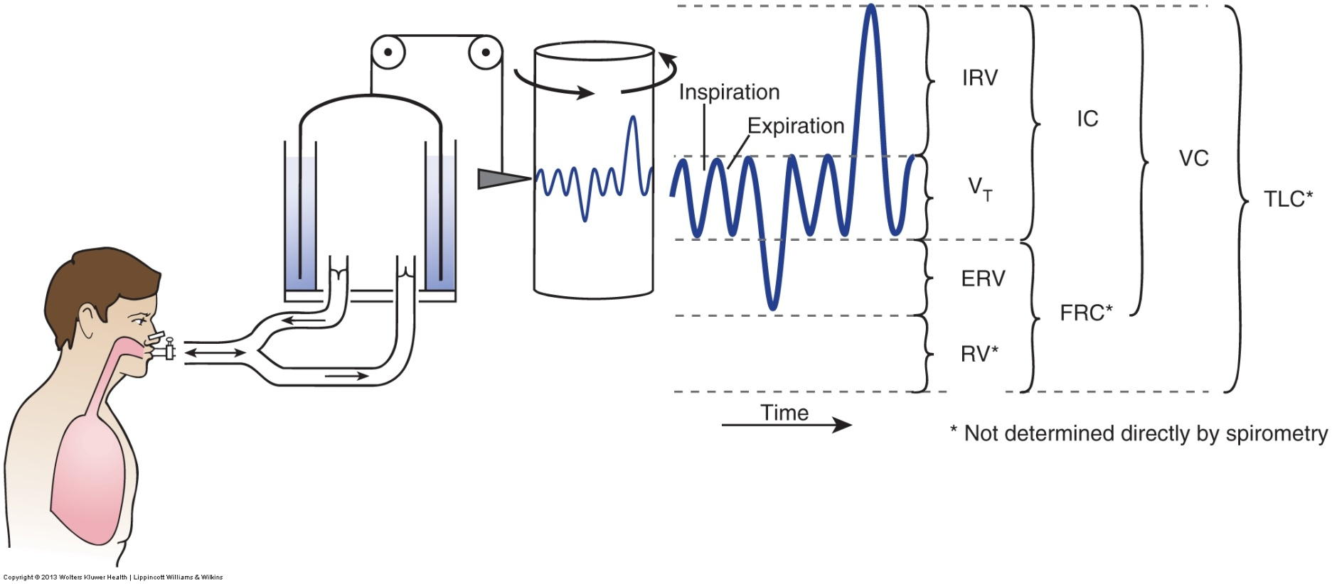
Spirometry Measurements are Used for 3 Analyses:
lung volume; 2. lung volume vs time;
3. airflow rates vs lung volume (flow-volume loops)
Notes:
4

Slide 5
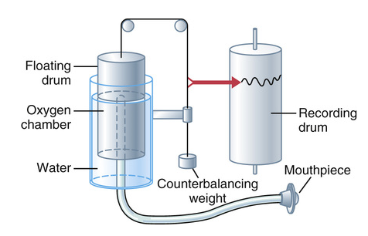
Two Types of Spirometers
Volume Displacement – Bell moves up and down as air is blown into and inhaled from device.
Has moving parts
Can be bulky
Holds its calibration
well

Slide 6
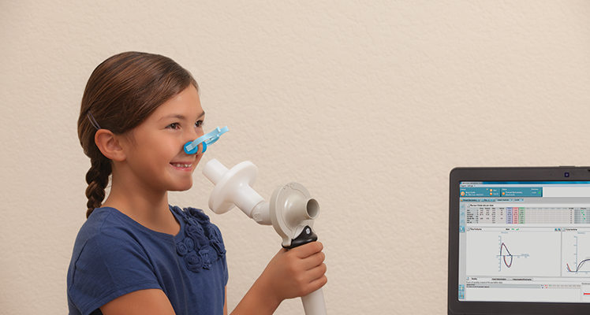
2nd Type of Spirometer
Integrated Pneumotachygraph – measures flow from subtle differences in pressure as air is moved through a screen
Electronic device
Volume derived from flow rate and time
Small and light weight
No moving parts
Needs frequent calibration
(Demo)

Slide 7
Demo of Pneumotachometer
We will measure lung volumes, lung capacities,
and forced expiratory volumes including FEV₁.

Slide 8
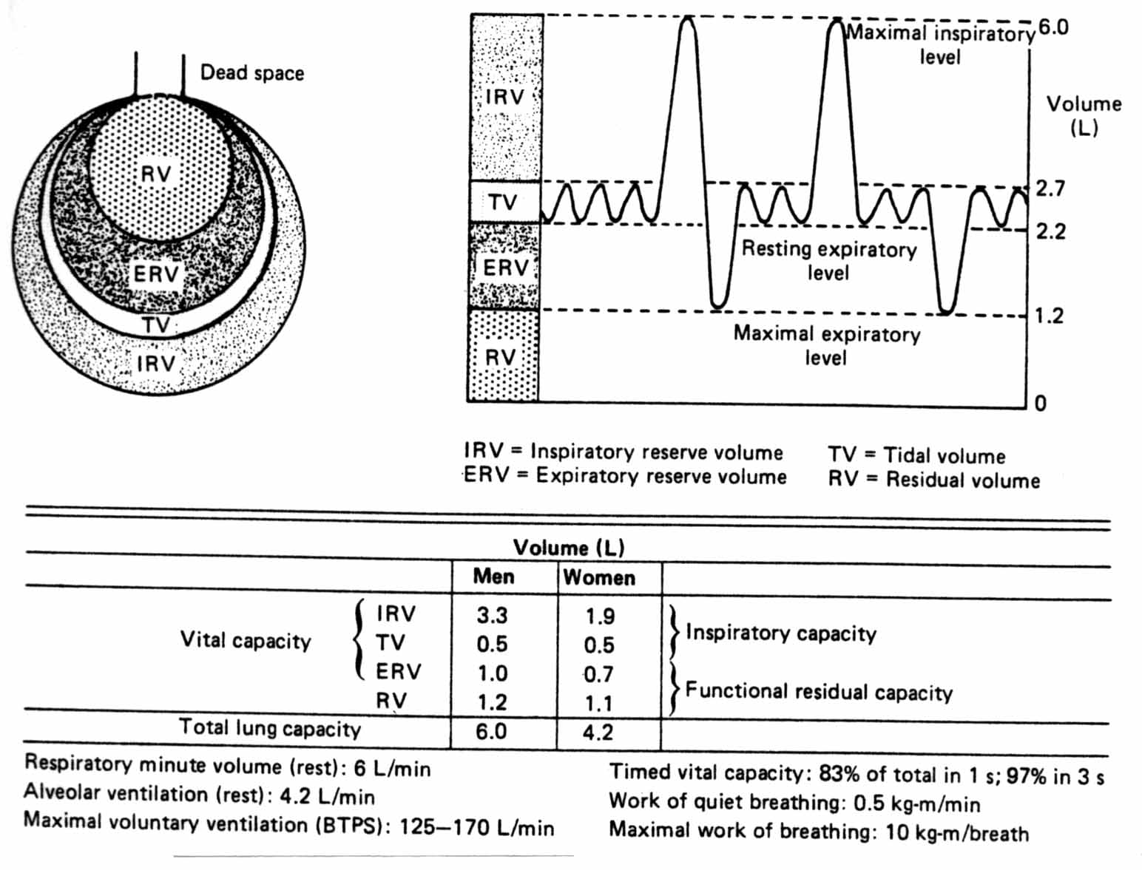
Lung Volumes and Capacities
Notes:
Which of the lung volumes increase with exercise in healthy individuals?

Slide 9
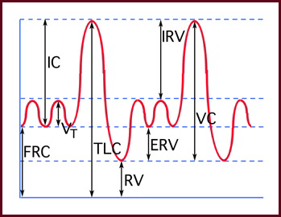
Lung Volumes
Tidal Volume – V_{T}– amount of air inhaled with a normal breath from the resting level. 500 mL
Inspiratory Reserve Volume-IRV – the max amount of additional air that can be inhaled beyond the V_{T}.
Expiratory Reserve Volume – ERV – the max amount of air that can be exhaled following a normal exhalation from the resting level.
Residual Volume – RV – the amount of air that remains after a maximal exhalation.
prevents fluctuations in gas exchange by maintaining oxygen during expiration
Notes:
If both IRV and ERV decrease with age, what increases? Practice drawing this graph without looking at it.

Slide 10
Your friend runs up the stairs to the 5th floor because the exam is about to start. When she sits down, you observe that her breathing frequency (no. of breaths/ min) is markedly increased. You also note that her depth of breathing (the volume of air she inhales/breath) is ______________ at rest.
greater than
less than
the same as
0 of 0

Slide 11
Lung Capacities
Total Lung Capacity sum of all 4 lung volumes
IRV + V_{T} + ERV + RV ~6 liters
Inspiratory Capacity (IC)
V_{T} plus IRV (resting level to full inspiration)
Functional Residual Capacity (FRC) “resting”
ERV plus RV (what remains after a normal breath)
Vital Capacity –From Maximal Inspiration to Maximal Expiration
IC (IRV + V_{T}) + ERV
Forced Vital Capacity (FVC)
FEV₁ = 80% FVC
Notes:
Does FRC increase, decrease or stay the same with age? What happens to VC with age?

Slide 12
Elastic Recoil of Chest Wall & Lungs Determines FRC
Chest wall normally tries to spring out*
Lungs normally try to collapse
Position at which these two forces balance each other is resting position = FRC
Is the lung capacity you come to after each normal breath
Always have air remaining in lung – even after forced expiration = RV
Notes:
* Chest wall springs out for all volumes below 70% of TLC. At lung volumes > 70% of TLC, the chest wall will recoil inwards because it is larger than its resting volume.

Slide 13
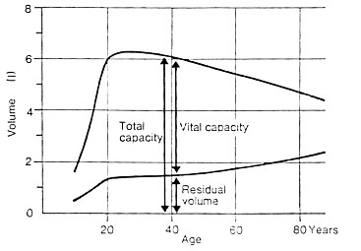
Effects of Aging on Lung Volumes and Capacities
With normal aging, elastic recoil of lung tissues decreases.
this causes ↑ RV, ↑ FRC and ↓ VC
TLC
Notes:
TLC may increase slightly with age in healthy adults but increases significantly in patients with emphysema. Why?

Slide 14
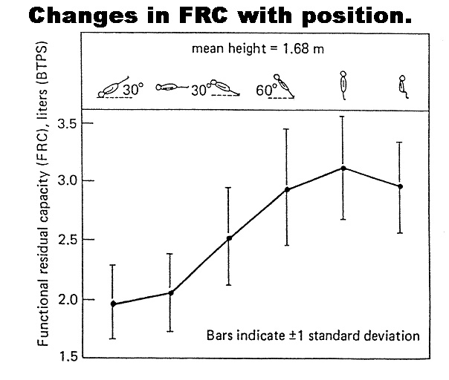
Body Position Affects Lung Volumes and Capacities
1. Lying down decreases FRC
abdominal contents shift toward thorax and ↓ ERV
2. The VC is unchanged because ↑ IRV
IC
IRV
IRV
IC
TLC
V_{T}
VC
V_{T}
ERV
FRC
ERV
FRC
RV
RV
Standing
Supine
Notes:
Note that in normal healthy individuals, RV does not change with body position. When supine, the passive movement of abdominal contents into the thorax can be thought of as starting to exhale, thus there is less volume left to exhale and a decrease in ERV.

Slide 15
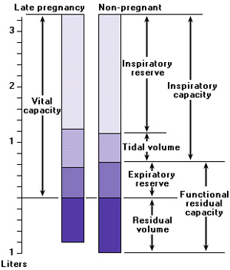
Effects of Pregnancy on Lung Volumes and Capacities
Pregnancy- diaphragm moves up
(4 cm) with fetus in uterus.
Thoracic wall expands.
With increasing fetal size,
decreased ERV, RV, and
FRC (by 20%).
Tidal volume increases.
VC does not change.
Notes:
During pregnancy, increased levels of progesterone, increased oxygen demand, increased CO₂ production drives the increase in tidal volume. Residual volume decreases because of the increased size of the fetus and decreased compliance of thorax.

Slide 16
Spirometry: Volume vs Time Measurements
FVC=Forced Vital Capacity
FEV1=Forced Expiratory Volume in 1 sec
Normally FEV₁ is 80% of FVC
Correction for lung size:FEV₁/FVCx100
Most reliable spirometry measurement
FEF25-75= Maximal Mid-Expiratory Flow Rate
Flow rate over middle half of FVC
Greatest sensitivity to detect early air flow obstruction.
Notes:
What do you predict will happen to FEV₁ in obstructive disease? Restrictive disease?

Slide 17
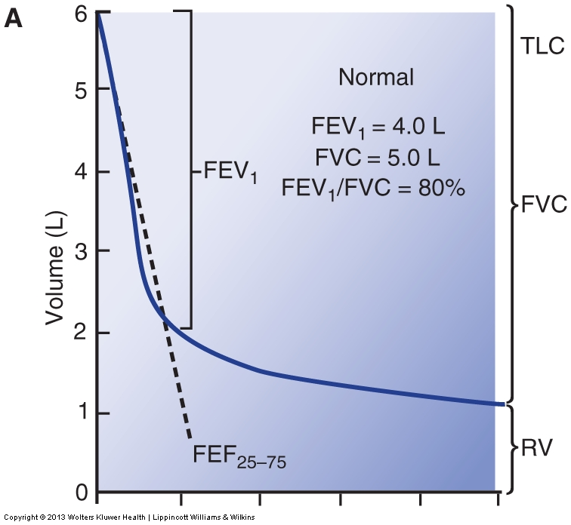
Forced vital capacity (FVC) is a useful measurement in assessing ventilatory function. Measures volume vs time.
NORMAL
Time (s)
Notes:
This graph shows that normal people can exhale 80% of their vital capacity in 1 sec.
17

Slide 18
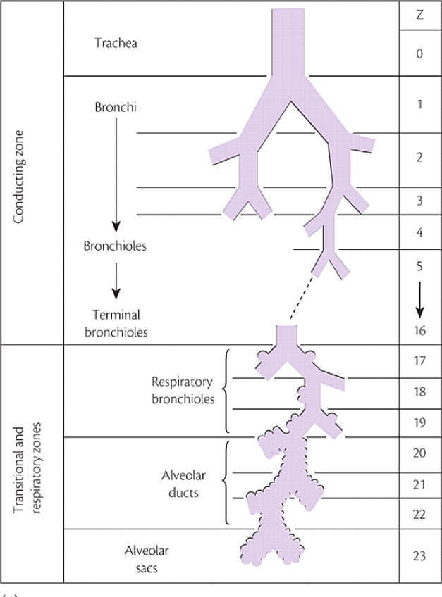
Using Airflow to Calculate Airway Resistance
PRESSURE = FLOW X RESISTANCE
RESISTANCE = PRESSURE/FLOW
Pressure measured at the mouth.
Flow measured by a pneumotachygraph in the mouthpiece.
Highest airway resistance of the lower respiratory tract is in the mid-sized
bronchi ( > 2 mm in diameter).
Notes:
The relationships shown above indicate that if airway resistance increases, airflow into and especially out of the lungs will decrease. What might increase airway resistance? Why do the midsized airways have the highest airway resistance?

Slide 19
Which of the following will most likely increase airway resistance?
Stimulation of sympathetic nerves innervating bronchial smooth muscle
Maximal forced inspiration
Breathing at high lung volumes
Breathing at low lung volumes

Slide 20
Airway Resistance
Parasympathetic stimulation constricts bronchial smooth muscle
Airway resistance decreases at large lung volumes due to increased diameters of airways.
Airway resistance increases at small lung volumes due to decreased diameters of airways.
Restrictive lung disease affects lung parenchyma, NOT airways.
The hallmark of obstructive disease is increased airway resistance during expiration.

Slide 21
Summary of Lecture 3
4 Lung volumes – residual volume (RV) cannot be measured with spirometry
4 Lung capacities – TLC & FRC cannot be measured with spirometry because both include RV
With aging, residual volume increases as elastic recoil decreases
Supine position ↓ ERV, ↓ FRC, and ↑ IRV
In pregnancy, ↓ ERV, ↓ RV, ↓ FRC and ↑ V_{T}
Airway resistance is inversely related to airflow

